Slide 1


WindowBuilder
Guillermo Esquivel González
Nicolás Hernández González
Programación de Aplicaciones Interactivas
Notes:
4/26/17
1
1

Slide 2
Index
What will we talk about?
What is WindowBuilder
How to install WindowBuilder
Short introduction for a quick start
Distribution of the window
Wizards
Layout Managers
Exmples
Notes:
4/26/17
2
2

Slide 3
What is WindowBuilder?
Java GUI designer
Makes easy creating complicated windows
Visual Designer and Java Code
Drag-and-Drop
Add event handlers
Notes:
4/26/17
3
3

Slide 4
Installation
In Eclipse, click Help > Install New Software…
Get the proper link from http://www.eclipse.org/windowbuilder/download.php
In the Available Software dialog, enter the product's update site location and select all the items to install. Click Next to continue.
Click Next to confirm installation.
Accept the license agreement. Click Finish.
Restart Eclipse.
Notes:
4/26/17
4
4

Slide 5
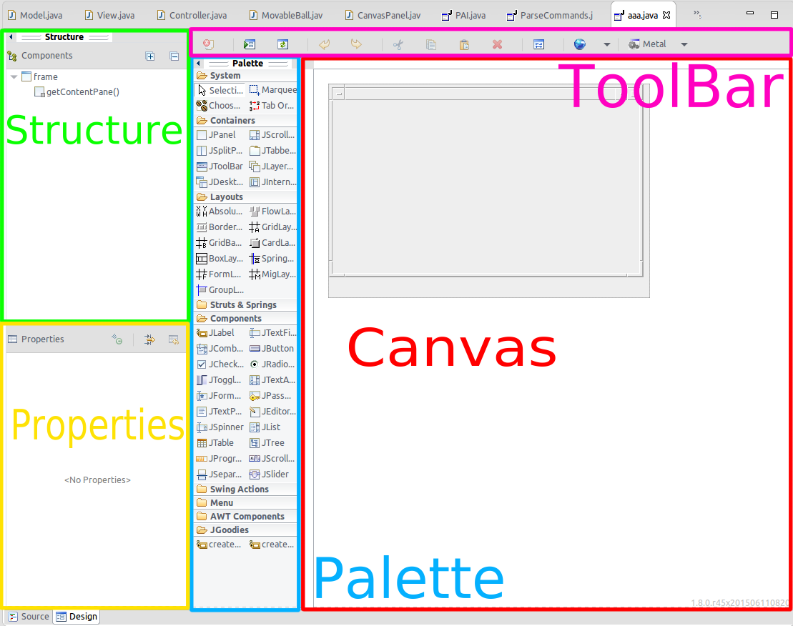
Distribution of the window
Design View
Source View
Structure View
Component Tree
Property Pane
Palette
Toolbar
Context Menu
Notes:
4/26/17
5
5

Slide 6
Short introduction for a quick start
Create a new project using the appropriate project wizard
Notes:
4/26/17
6
6

Slide 7
Short introduction for a quick start
Use class wizard to create your GUI window
Notes:
4/26/17
7
7

Slide 8
Short introduction for a quick start
A class with some existing code is created.
Notes:
4/26/17
8
8

Slide 9
Short introduction for a quick start
To use the windowBuilder click on the "Design tab" at the bottom of the editor
Notes:
4/26/17
9
9

Slide 10
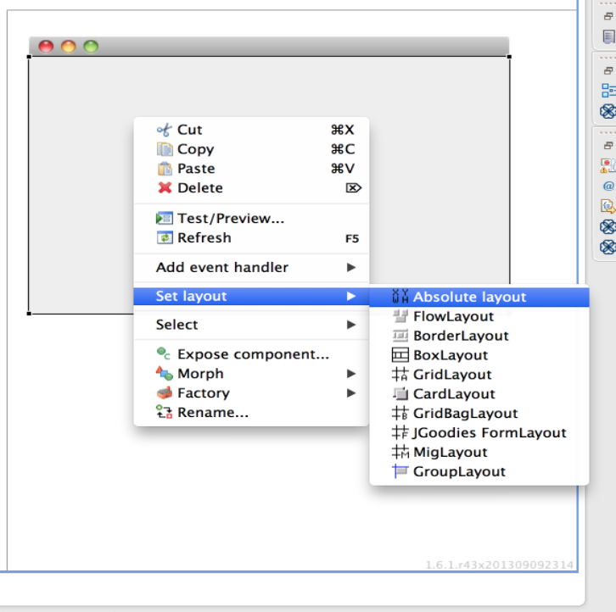
Short introduction for a quick start
To set layout, right click on the window frame and select " set layout " and select the appropriate layout
Notes:
4/26/17
10
10

Slide 11
Short introduction for a quick start
Add various components from the Palette and edit their properties using the Property Pane.
Notes:
4/26/17
11
11

Slide 12
Short introduction for a quick start
Add event handler to various widgets to provide behavior
Notes:
4/26/17
12
12

Slide 13
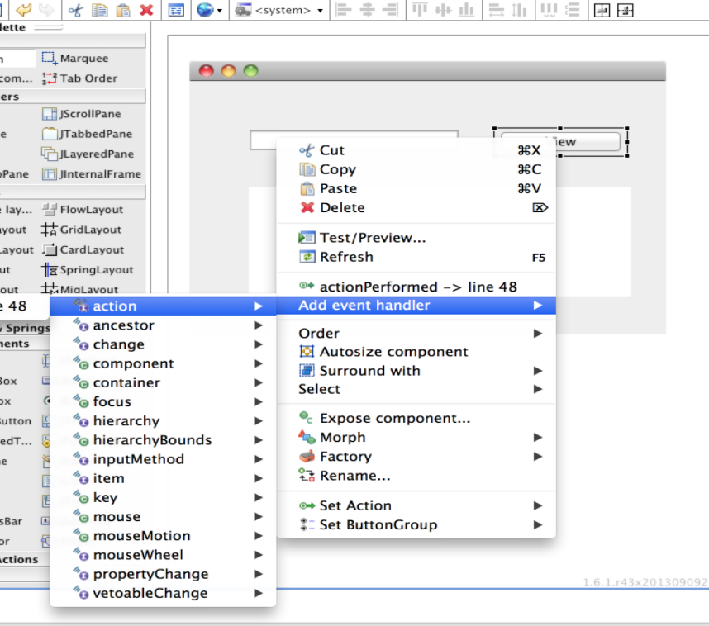
Short introduction for a quick start
If you create a new Composite or Jpanel, you can embed it in another window using the Choose Component command.
Notes:
4/26/17
13
13

Slide 14
Features
WYSIWYG visual designer and editin
Notes:
4/26/17
14
14

Slide 15
Features
Flexibility and consistency across frameworks
Notes:
4/26/17
15
15

Slide 16
Features
Bi-directional code generation (round-trip editing)
Notes:
4/26/17
16
16

Slide 17
Features
Drag-and-drop
Notes:
4/26/17
17
17

Slide 18
Features
Wizards and templates
Notes:
4/26/17
18
18

Slide 19
Features
Reverse engineering capabilities
Notes:
4/26/17
19
19

Slide 20
Features
Localization and Internationalization
Notes:
4/26/17
20
20

Slide 21
Features
Minimal code changes
Notes:
4/26/17
21
21

Slide 22
Features
Morphing tools
Notes:
4/26/17
22
22

Slide 23
Features
Factories
Notes:
4/26/17
23
23

Slide 24
Features
Data Binding
Notes:
4/26/17
24
24

Slide 25
Features
Auto-discovery of Uisupported frameworks
Notes:
4/26/17
25
25

Slide 26
Wizards
Swing
JFrame
JPanel
JDialog
JApplet
JInternalFrame
Application Window
Automatic Data Binding
Notes:
4/26/17
26
26

Slide 27
Bibliography
Help eclipse
Eclipse windowBuilder
Eclipse proposals windowBuilder
Notes:
4/26/17
27
27

Slide 28

END
THANKS!
You can find as alu0100881677 & alu0100898293
Slides and code at Github repo
Any Question?
Notes:
4/26/17
28
28

